Slide 1


Introduction to AlphaFold: Bioinformatics for 3D Protein Structure Prediction
Devon J. Boland
Norman Borlaug Endowed Research Scholar

Slide 2
The Field of Bioinformatics
“Omics”-Based
Genome
Transcriptome
Proteome
Molecular Dynamic Simulations
Annotation
Image/Microscopy Analysis
Gene/Protein Expression
Structural Proteomics

Slide 3
What Does Protein Structure Tell Us?
Structure = Function → Function = Structure
visualizing binding interface
location of allosteric inhibition
conformational changes
molecular scaffold for molecular docking
mutational design
MANY OTHER FACETS…
SARS-COV-2

Slide 4
Basics of 3D Protein Structure
Four Tiers of Protein Structure
1° - Sequence of AA’s (polypeptides)
2° - Interactions of the carbon backbone of 1°
3° - Folding of 2° onto itself
4° - Multiple 3° units (Monomers) assembling together
Different Types of Quaternary Structure
A
A
A
A
B
A
A
B
A
B
A
Dimer
(homo)
Dimer
(hetero)
Trimer
(homo)
Tetramer
(hetero)
https://en.wikipedia.org/wiki/Protein_structure

Slide 5
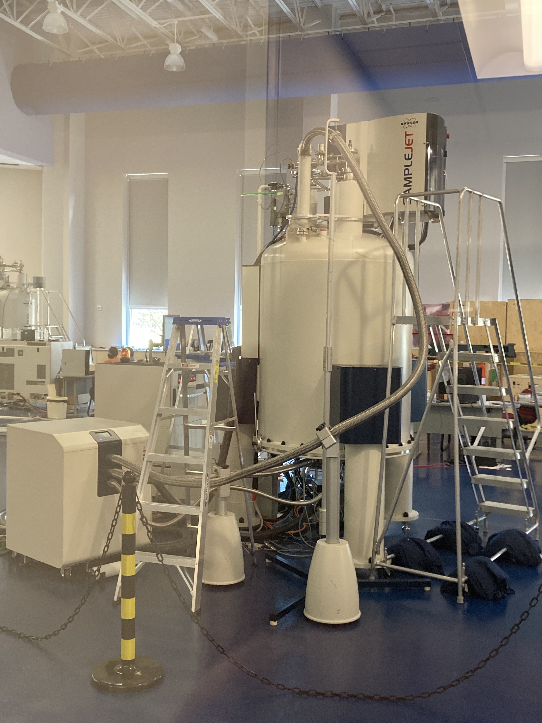
Methods for Elucidating Protein Structure
NMR Spectroscopy
Cryo-EM
X-Ray Crystallography
pros:
widely used
high-throughput
~2.5-1Å resolution
cons:
crystallization process
high variation
pros:
native state
non-destructive
real-time
cons:
only works on “small” proteins
<100kDa
high [protein]
$$$ maintenance
pros:
large proteins/complexes
near-native state
cons:
only works on “large” proteins
>200kDa
freezing samples
computationally intensive
$$$ maintenance

Slide 6
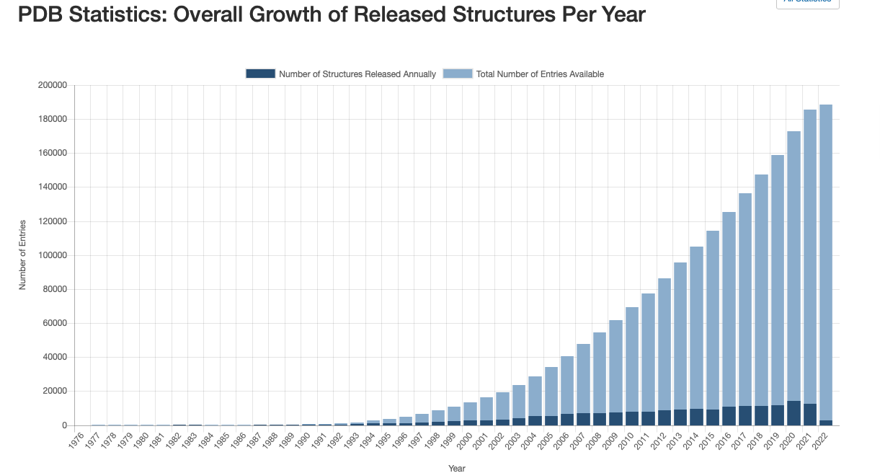
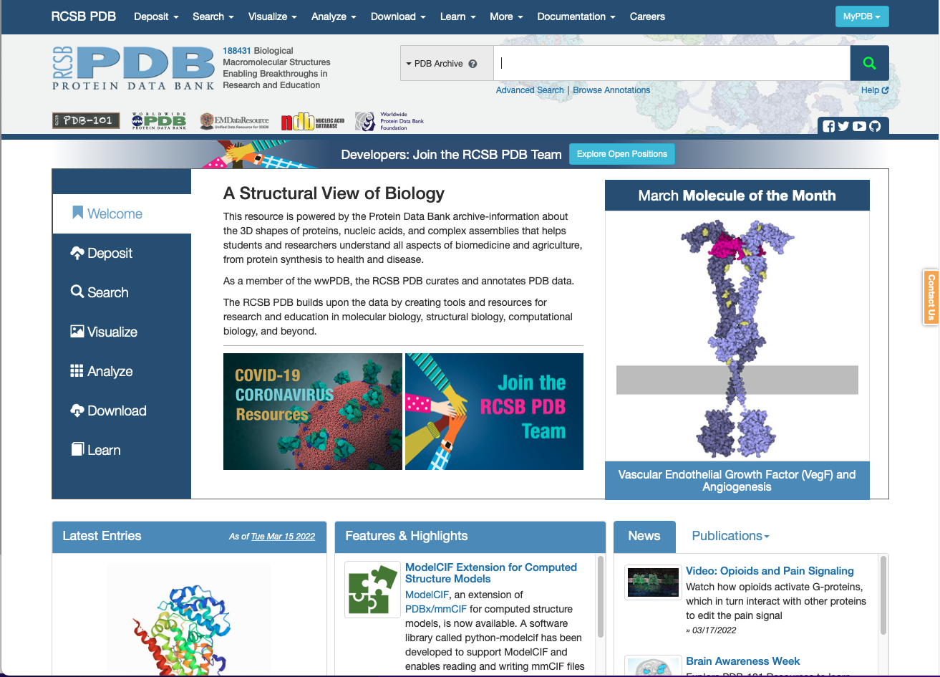
Protein Data Bank (PDB)
After we elucidate a structure where does it go?
Most publishing journals require a structure be deposited to the PDB prior to publication of a study!

Slide 7
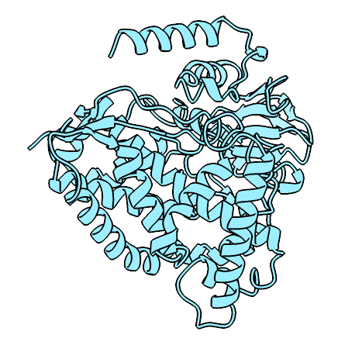
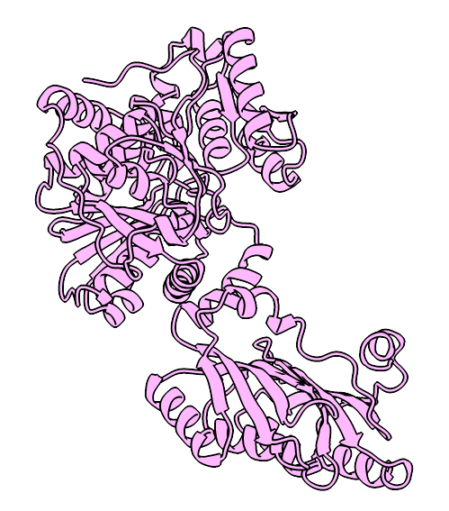
Enter Computers! (Not The One In Your Pocket)
Parameters that MUST be considered:
Primary Structure (bond angles)
Secondary Structure (⍺-helix, β-sheet, loops)
Tertiary Structure (folding of secondary structure)
Quaternary Structure (Optional)
3°/4° Structure Have Additional Parameters:
Conserved protein domains
Protein families/superfamilies/clans
Ideally, we would like to predict a protein’s 3-D structure given only its AA sequence (1° stucture)
Algorithm-Based
Machine Learning (AI)

Slide 8
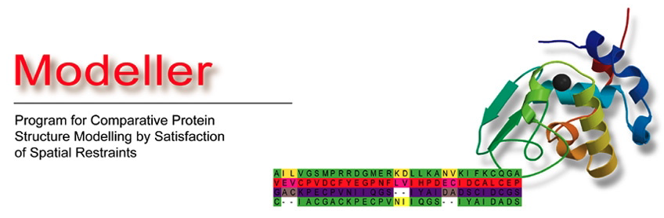

Web-Server Based Algorithm Driven Software
Widely used molecular replacement modeling system
Often paired with X-ray crystallography during the refinement step
Best case use when a high sequence homolog exists
CASP rated highest for blind protein search/modeling
Completely open-source
Fully-integrated with ExPASy Suite
Extensive manually curated databases
All of these solutions heavily rely on homology to some characterized protein

Slide 9
Assessing Methods for Protein Structure Prediction
CASP evaluates current methods of predicting protein structure since 1994.
“These techniques are expensive and slow: it can take hundreds of thousands of dollars and years of trial and error for each protein. AlphaFold can find a protein’s shape in a few days.” - MIT Technology Review
2020 was the first year a program met a true success rate (>90%)
Google DeepMind’s AlphaFold2
Worked on both homologous and novel proteins
Only needed to provide the AA sequence
AlphaFold2 was released under the Apache Common Use license in 2021

Slide 10
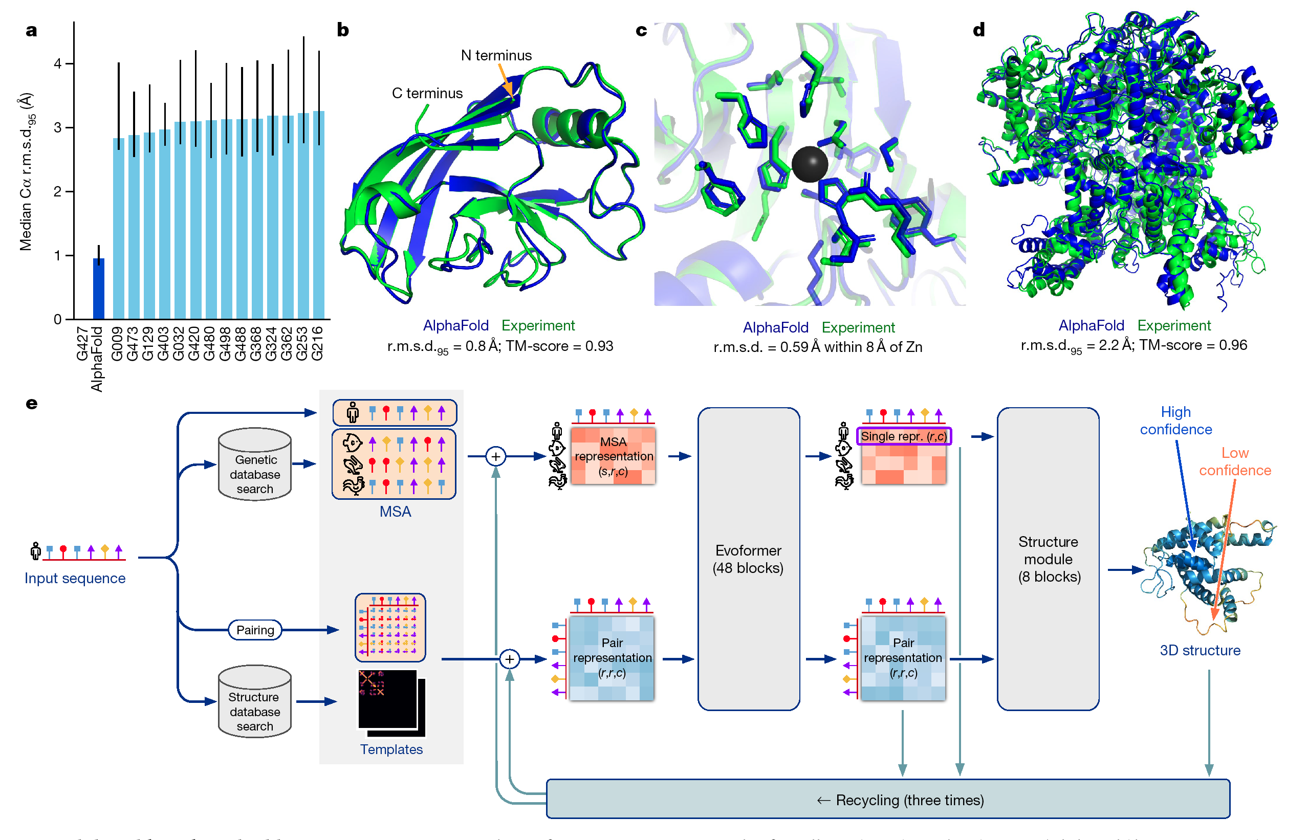
AlphaFold2: A Neural Network Trained To Predict Protein 3-D Structure
First program to ever meet the success rate at CASP
Assessed on alignment of predicted structure to experimental
AF2 custom value to “quantify” model confidence
Jumper, et. al. 2021 Nature.

Slide 11
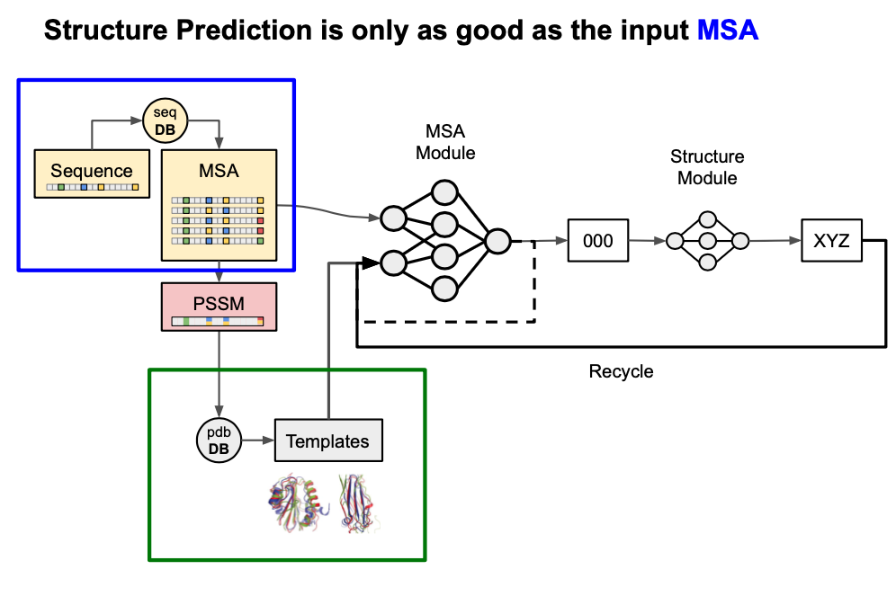
MSA Depedency of AF2
https://docs.google.com/presentation/d/
Xu, J.et. al. Proteins 2019, 87 (12), 1069-1081.
Typically MSA depth of >100 sequences/residue produce a highly accurate and confident model

Slide 12
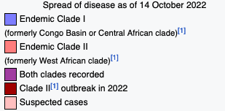
MPOX (Monkey Pox)
MPOX first isolated 1958
Copenhagen, Denmark
Started in children from a playgroup
Easily diagnosed by lesions that develop in 2-27 days
Can spread to genitalia
Can cause:
pneumonia, sepsis, and stillbirth (pregnancy)
Genome ~197kb
Contains 190 protein-encoding genes
We will predict structures for 60 of these proteins
To date only two proteins have been elucidated
MPXV polymerase holoenzyme in replicating state
Profilin-like Protein
PDB: 8HG1
PDB: 4QWO

Slide 13
Assembly of the MPOX-22 Global Outbreak Genome
Genome Sequencing & Assembly
Gene ORF Prediction & Annotation

Slide 14
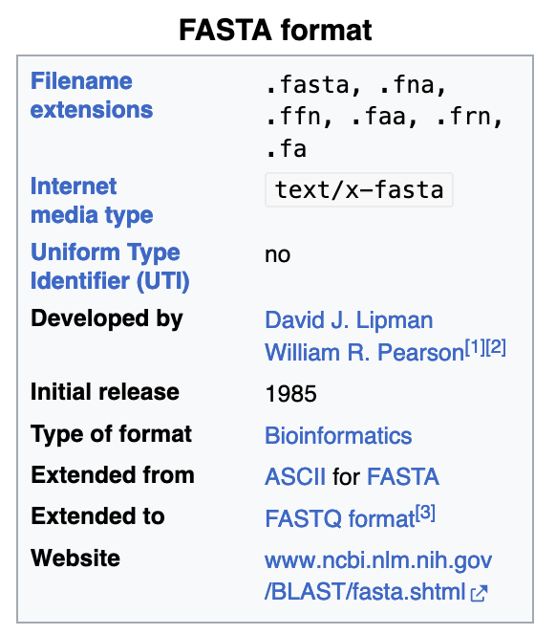
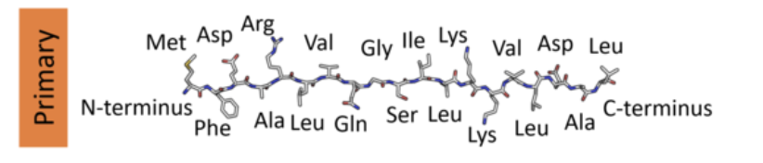
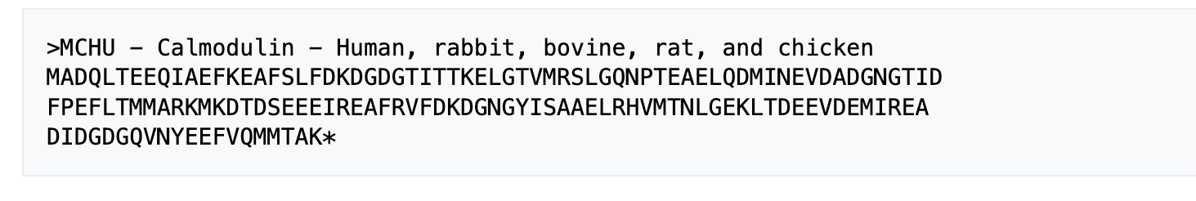

Pearson Fasta Format
In vivo “Biological” Representation
In silico “Computer” Representation
They are separated by the ‘>’ sign
Followed by a descriptor, known as a ‘header’
How would you represent a genome on a computer?
What about a transcriptome? or proteome?
Each sequence is represented as two lines
The next line contains the amino acid sequence

Slide 15
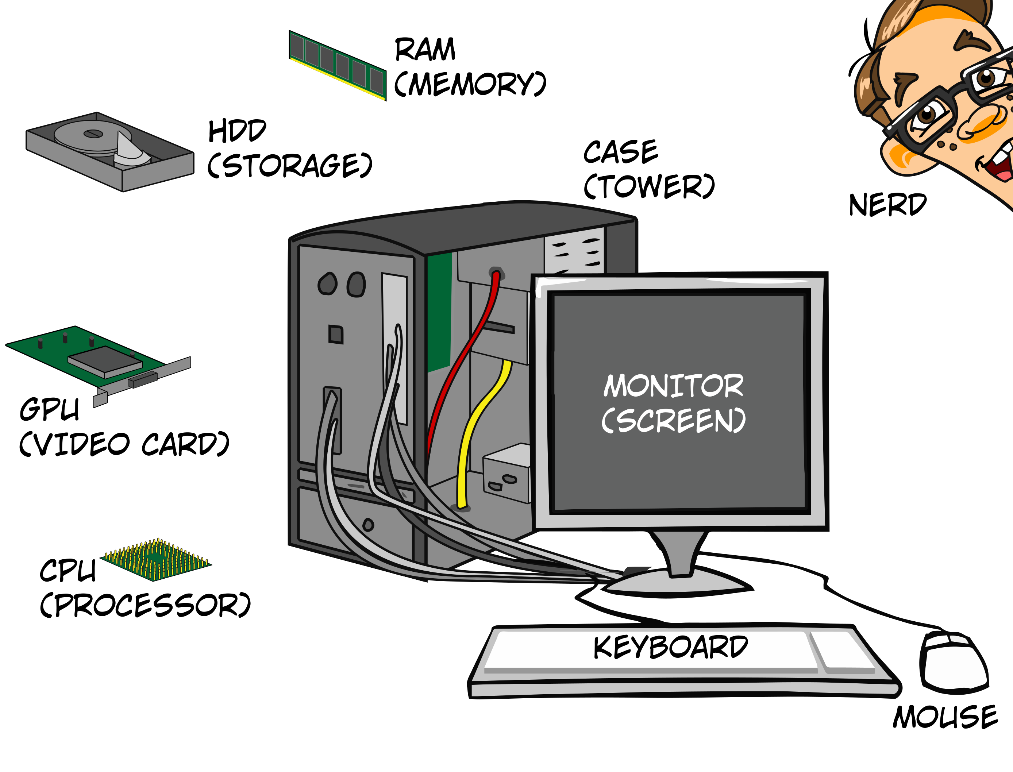
AF2 is Not a Well Optimized Program
Me…

Slide 16
Running AlphaFold2 In A Timely Manner
Hours-Days
>50 years
Months - Years
4-8 CPU core
CUSTOM Graphics Chip
8-16Gb RAM
8-10 CPU core
NVIDIA/AMD Entry GPU
16-32Gb RAM
925 nodes (40cpu per node)
NIVIDIA A100/AMD Ryzen GPUs
>3TB RAM

Slide 17
Architecture of HPC Clusters
Photo: Illinois State University (ISU.EDU)
Photos: GitHub HPCTraining

Slide 18
Process of Running A Job On Grace
Unlike to your personal computer, Grace will not do things automatically
We will build a list of commands which will include running AlphaFold2
This is called “scripting/building” a job file
Our job file will contain “directives” and “commands”
Directives - tell Grace what resources to use (CPU/GPU/Time/RAM)
Commands - will execute programs or lines of code
Once we submit the job, the job goes to the SLURM batch scheduler

Slide 19
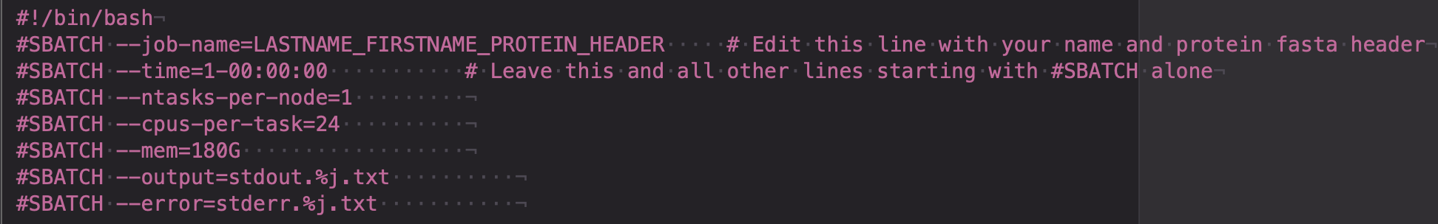
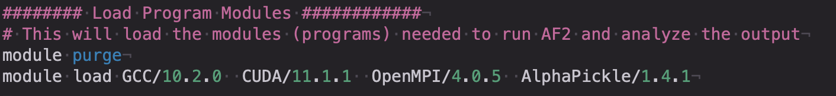
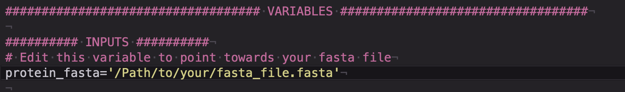
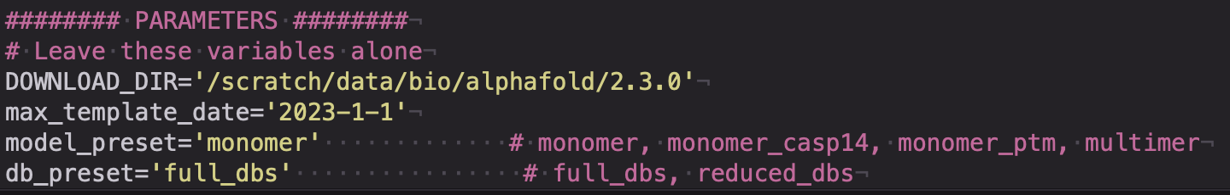
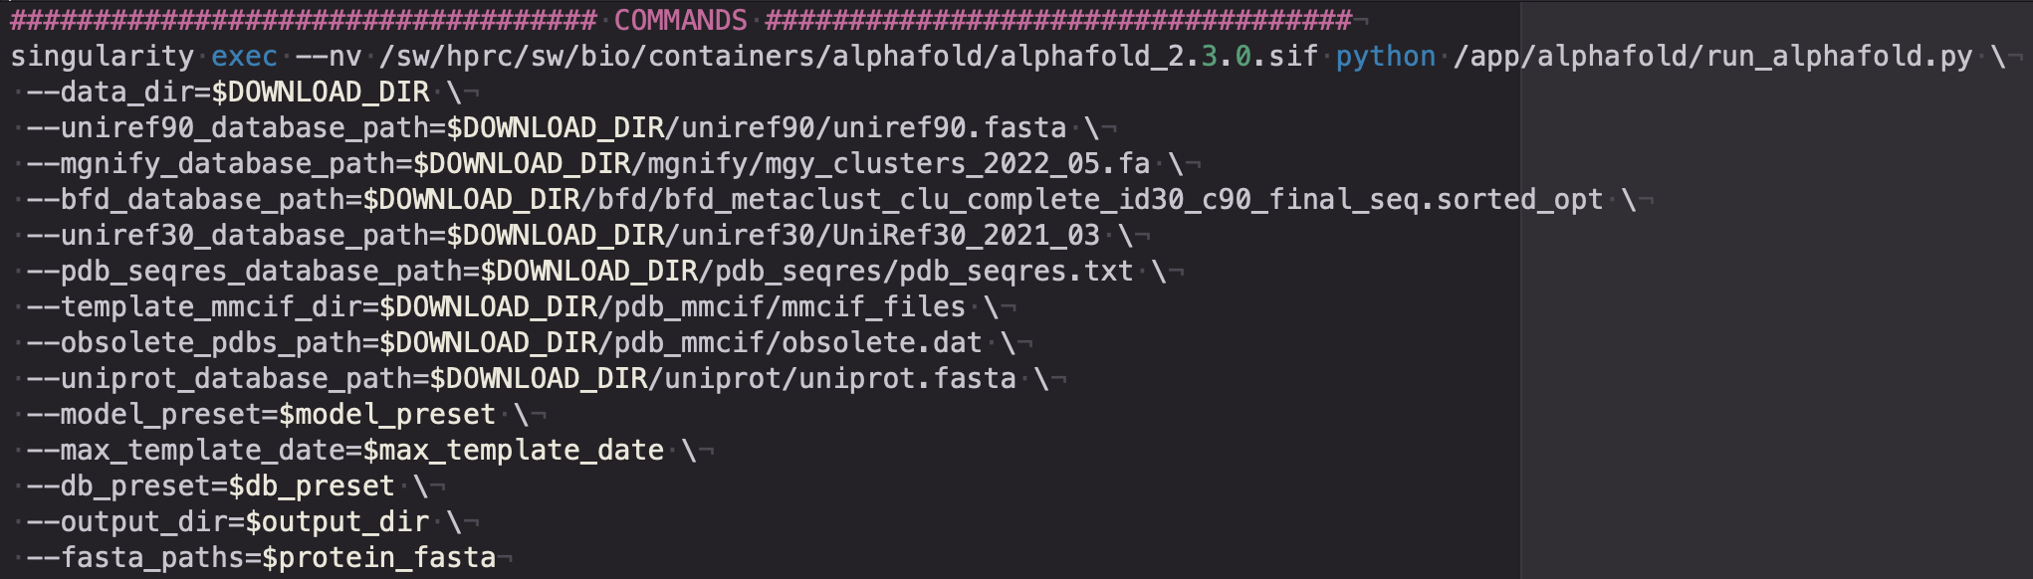
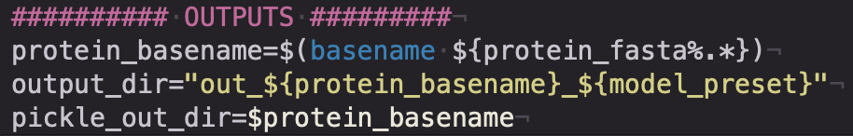
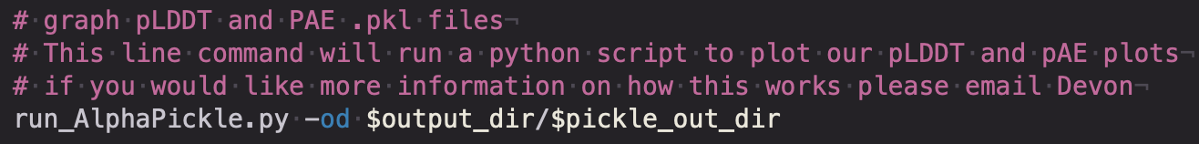
The AlphaFold2 Job Script
Directives - tells the computer what hardware to use
Modules - tells the computer what software to use
Variables - our input for the program
Parameters - “arguments” the program uses, typically specific to your data
Commands - specific to the program, and tell the computer what to do
Variables - specific to the program you are using

Slide 20
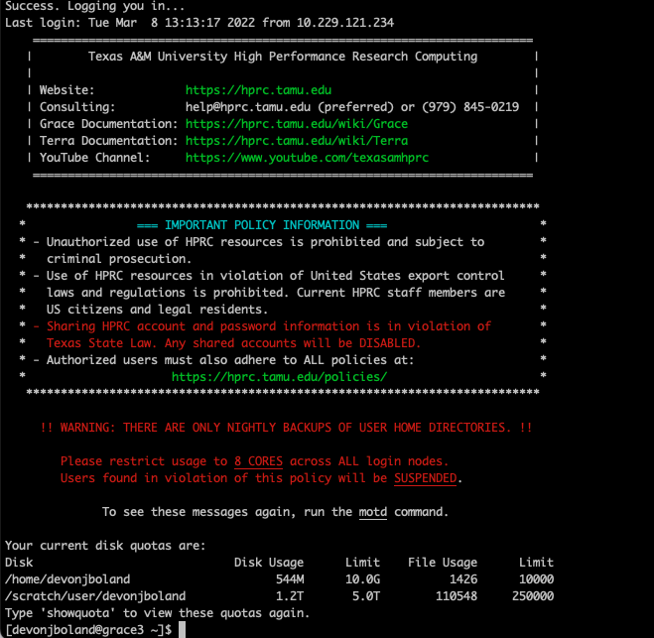
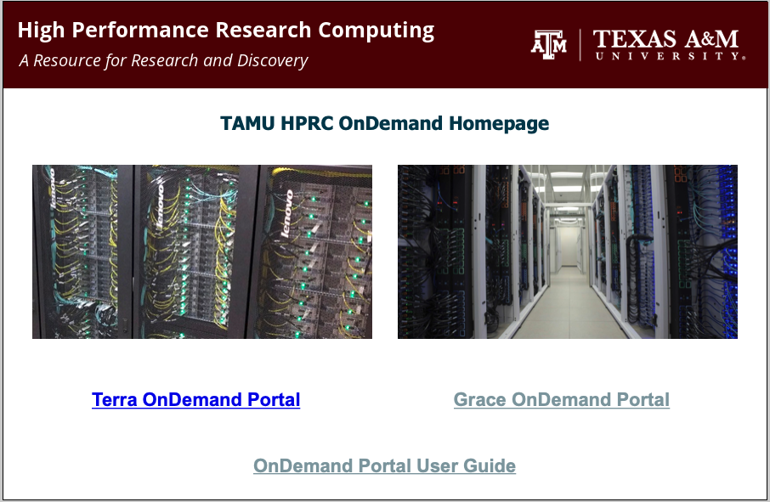
Interfacing with Grace
Terminal via SSH (Local Client)
OnDemand Portal (Web Browser)

Slide 21
Summary
AlphaFold2 was the first program to be considered a success for protein structure prediction
It works on proteins with structural homologs, and those without
Its major limitation is still requiring homologous sequences for accurate structure prediction
Its dependent on two parts:
Finding homologous sequences
Finding homologous structures
The confidence of the model is expressed as pLDDT and pAE
When in doubt, run AF2 on your protein, worst that happens is you waste your time
Any Questions!
Next Time
We will analyze the predicted structures

